Slide 1
IPL DATA Analysis using power bi
BY :- SAKET DURGAPAL
BATCH NAME:- MIP-DA-12

Slide 2
oBJECTIVE
The goal of this Power BI project is to analyze IPL (Indian Premier League) cricket data to gain insights into team and player performance, match outcomes, and various key metrics related to both batting and bowling.
The analysis will be carried out using data from multiple related tables, providing a comprehensive view of the tournament's dynamics.

Slide 3
Dataset :
Fact Bowling :
▪ match_id: Unique identifier for the match.
▪ match: Description or name of the match.
▪ bowlingTeam: Name of the team that is bowling.
▪ bowlerName: Name of the bowler.
▪ overs: Number of overs bowled by the bowler.
▪ maiden: Number of maiden overs bowled.
▪ runs: Runs conceded by the bowler.
▪ wickets: Wickets taken by the bowler.
▪ economy: Economy rate of the bowler.
▪ 0s: Number of dot balls bowled.
▪ 4s: Number of fours conceded.
▪ 6s: Number of sixes conceded.
▪ wides: Number of wide balls bowled.
▪ noBalls: Number of no balls bowled

Slide 4
2) Fact Batting Summary:
▪ match_id: Unique identifier for the match.
▪ match: Description or name of the match.
▪ teamInnings: The team batting in the innings.
▪ battingPos: Batting position of the player.
▪ batsmanName: Name of the batsman.
▪ out/not_out: Whether the batsman was out or not out.
▪ runs: Runs scored by the batsman.
▪ balls: Balls faced by the batsman.
▪ 4s: Number of fours hit.
▪ 6s: Number of sixes hit.
▪ SR: Strike rate of the batsman

Slide 5
3) Dim Player:
▪ name: Name of the player.
▪ team: Team the player belongs to.
▪ battingStyle: Batting style of the player (e.g., Right-hand bat).
▪ bowlingStyle: Bowling style of the player (e.g., Right-arm fast).
▪ playingRole: Role of the player (e.g., Batsman, Bowler).
Dim Match Summary:
▪ team1: Name of the first team.
▪ team2: Name of the second team.
▪ winner: Winner of the match.
▪ margin: Margin of victory.
▪ matchDate: Date of the match.
▪ match_id: Unique identifier for the match.:

Slide 6
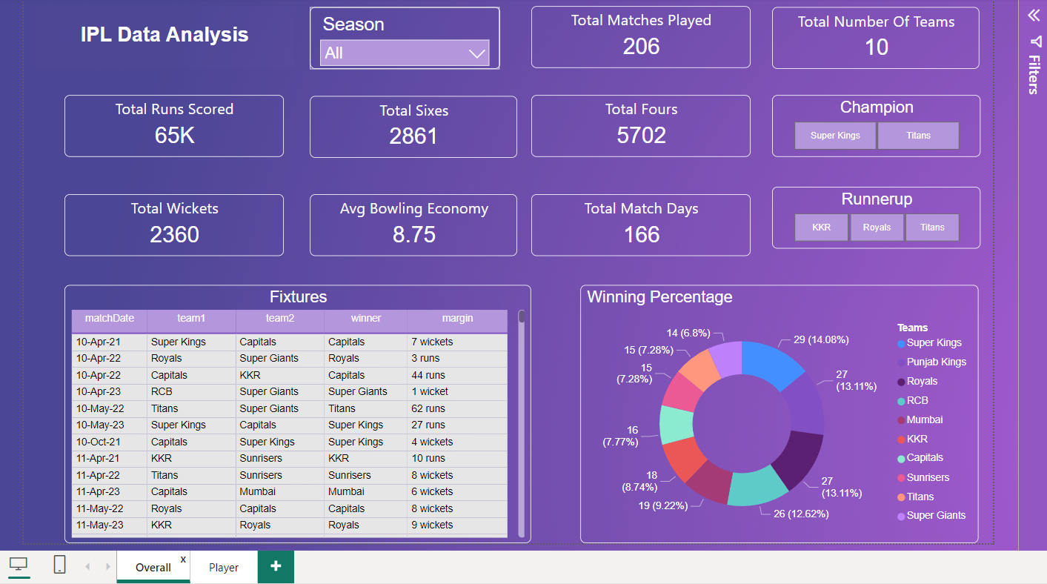
Powerbi DashBoards

Slide 7
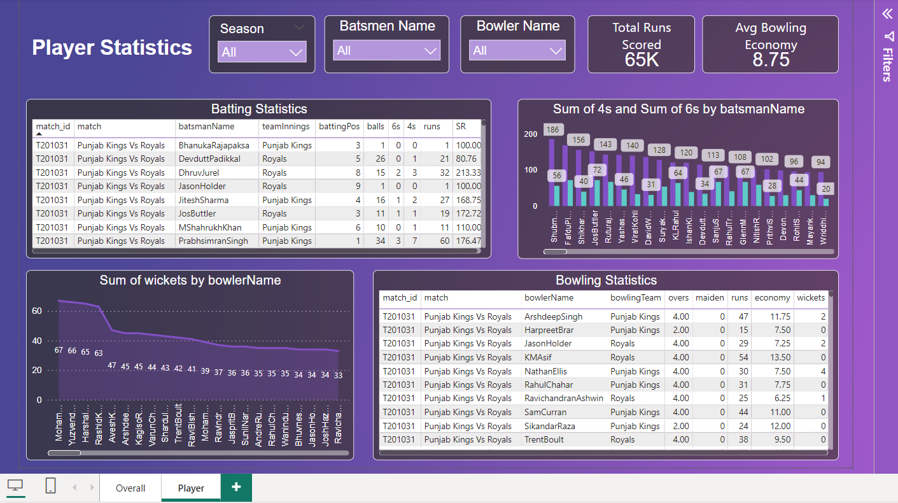

Slide 8
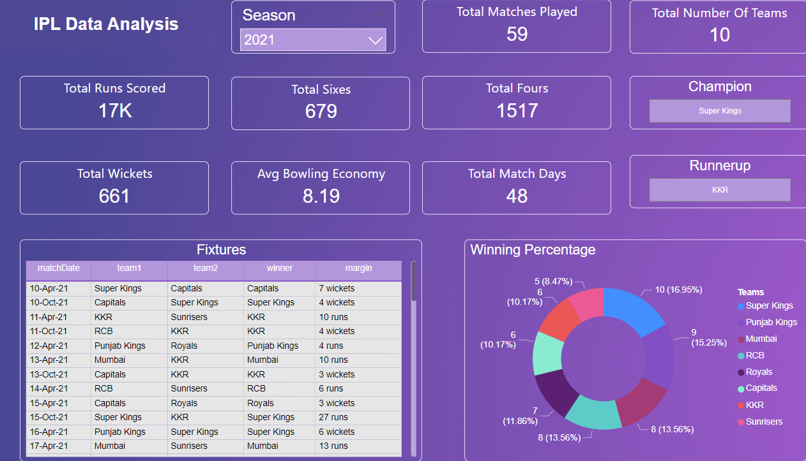
Key insights and findings
Season 2021:
Total 59 match are played between 10 teams in 48 days.
Super Kings are champion while KKR is Runner-up.
Approx. 17 thousand runs are made and 661 wickets have been taken in the tournament.
679 sixes and 1517 fours are scored during the tournament.

Slide 9
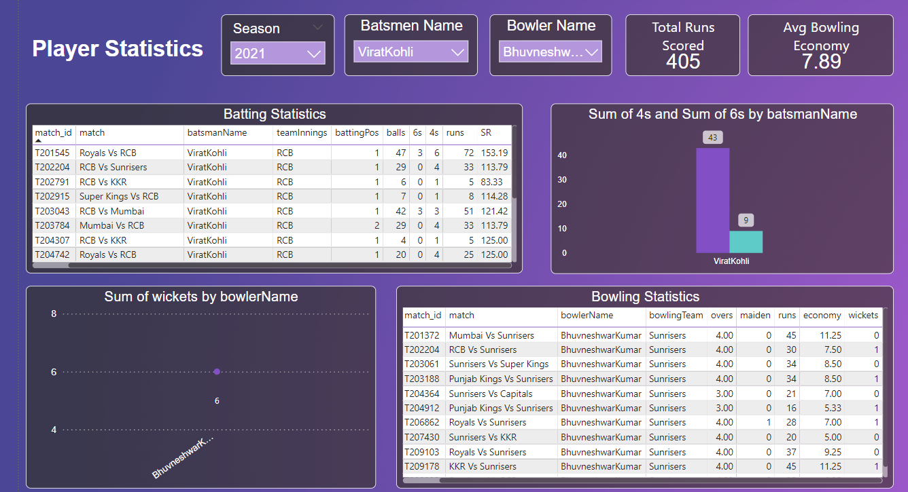
Player Stats: Taking Virat Kohli as Batsmen and Bhuvneshwar Kumar as Bowler.
As per the provided data set Virat kohli scored 405 runs and Bhuvneshwar kumar took 6 wickets.
43 fours and 9 sixes are scored by Virat kohli. Bhuvneshwar maintained 7.89 as avg bowling economy throughout season.

Slide 10
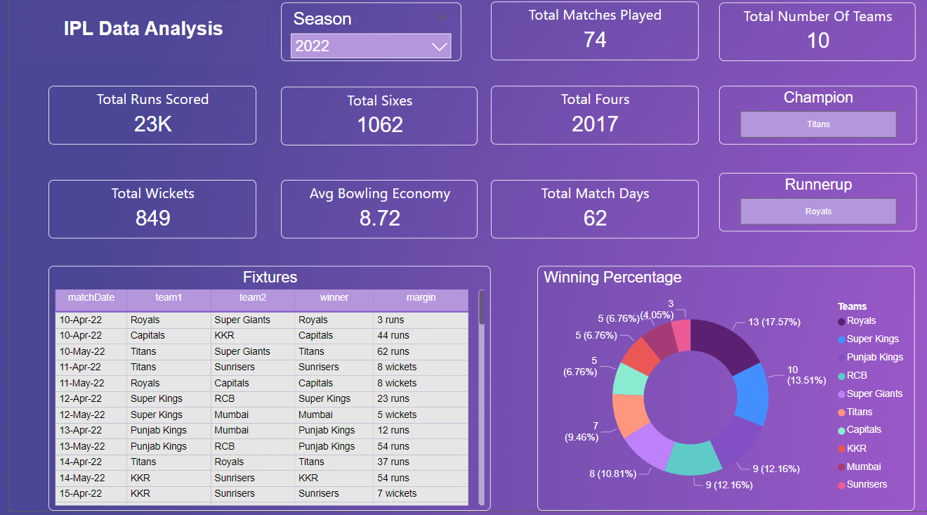
Season 2022:
Total 74 match are played between 10 teams in 62 days.
Titans are champion while Royals is Runner-up.
Approx. 23 thousand runs are made and 849 wickets have been taken in the tournament.
1062 sixes and 2017 fours are scored during the tournament.

Slide 11
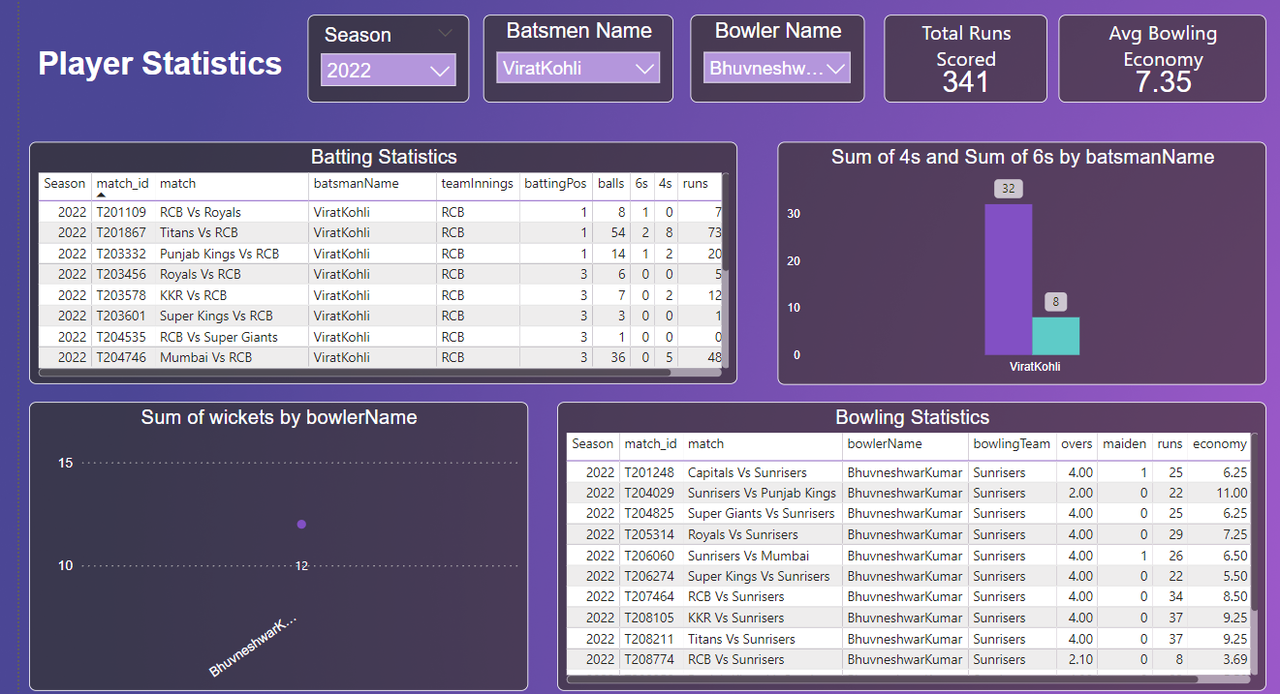
Player Stats: Taking Virat Kohli as Batsmen and Bhuvneshwar Kumar as Bowler.
As per the provided data set Virat kohli scored 341 runs and Bhuvneshwar kumar took 12 wickets.
32 fours and 8 sixes are scored by Virat kohli. Bhuvneshwar maintained 7.35 as avg bowling economy throughout season.

Slide 12
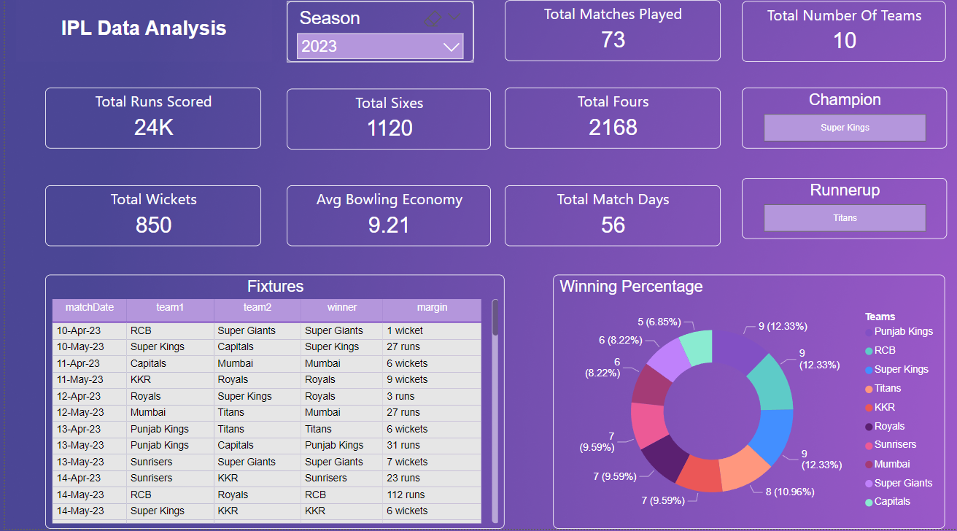
Season 2023:
Total 73 match are played between 10 teams in 56 days.
Super Kings are champion while Titans is Runner-up.
Approx. 24 thousand runs are made and 850 wickets have been taken in the tournament.
1120 sixes and 2168 fours are scored during the tournament.

Slide 13

Player Stats: Taking Virat Kohli as Batsmen and Bhuvneshwar Kumar as Bowler.
As per the provided data set Virat kohli scored 639 runs and Bhuvneshwar kumar took 16 wickets.
65 fours and 16 sixes are scored by Virat kohli. Bhuvneshwar maintained 8.32 as avg bowling economy throughout season.

Slide 14
conclusion
The dashboard delivers a powerful tool for IPL fans, analysts, and stakeholders to explore the rich history and statistics of the league.
By combining the extensive IPL dataset with the data visualization capabilities of Power BI, the dashboard surfaces meaningful insights that would be difficult to uncover through manual analysis of the raw data.
Overall, the IPL analysis dashboard demonstrates the value of leveraging data analytics and visualization to gain a deeper understanding of sports performance and trends.
The insights surfaced by the dashboard can inform strategy, marketing, and fan engagement for the IPL and its stakeholders.

